Slide 1


Slide 2

30 Days
Data Scinece & Analytics Master Class
Day1 : Python for Data Science
Time: 6.00 PM IST
Free Registration

Slide 3
30 Days
Data Scinece & Analytics Master Class
Handbook

Slide 4
NANDHINI.S
Exp: 5 Yrs
Expert in
Python Developer on Machine Learning
Deep learning with computer vision
Matlab – Image Processing
Autonomous Car design using ROS with LIDAR
Language – Python , Java , HTML ,CSS.
Tools – ANACONDA NAVIGATOR, JUPYTER NOTEBOOK,
GOOGLE COLAB.
Graduation : BE – ECE | 2011

Slide 5
Pantech?
Educational Equipment Manufacturer
  IoT, AI, Robotics,Autonomous Robot
  Microprocessor/Microcontroller
  DSP,VLSI, Embedded System
  Power Electronics & Drives, Fuel Cell Trainer Kit
  Renewable Energy Lab, Electric Vehicle Lab
Technical Training
DIY Project

Slide 6

What is Master Class ?
👍 This is the 30 Days Industrial Learning Activity.
👍 Its Online YouTube Live Class
👍 If you Invest 45 minutes daily, U will become Master in Data Science
👍 You will get FREE E-Certificate
Webinar Participation Certificate
“Learning is the beginning of wealth.
Searching & Learning is where the miracle process all begins.” …………….Jim Rohn

Slide 7
Our Vision
Help 10 Million Students to Learn the Technology in Easy Way

Slide 8

Associate Partner for this Master Class
https://apssdc.in/home/

Slide 9
What U will Learn from 30 Days Data Science & Analytics Master Class

Slide 10

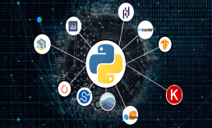


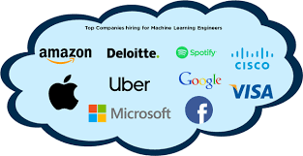
Data Science & Analytics Learning Plan
01
02
03
04
05
Library
Python
Analytics
Tools
Industry Project
Introduction To Python and Python Data Structures
Pandas
Numpy
MatplotLib
Cborn, SKLearn Lib
Collab
Distribution
Visualization
Aggregation
Statistics
PowerBi
Tableo
Project Building,
DSA Jobs

Slide 11
Day wise Learning Plan
Day -1 : Python for Data
Science (5 Solved end-to-end Data Science Projects in Python)
Day -2: Advanced Python Programming
Day -3: Pandas Library – Introduction
Day -4: Pandas Library – Data Structures
Day -5: Numpy library – Array Operations | Mathematical Functions
Day -6: Numpy – Sort, Search and Counting Functions
Day -7: Matplotlib , Histogram Using Matplotlib | I/O With Numpy
Day -8: Matplotlib Library – Introduction , Pyplot API | Types Of Plots
Day -9: Seaborn Library
Day -10: SKLearn Library
Day -11: Google Colab Notebook
Day -12: Python – Date and Time, Data Wrangling
Day -13: Python – Data Aggregation
Day -14: Python – Word Tokenization , Stemming and Lammetization
Day -15: Python – Data Visualization

Slide 12
Day wise Learning Plan
Day -16: Python – Statistical Analysis
Day -17: Python – Types Of Distribution
Day -18: Python – Correlation ,Chi-Square Test , Linear Regression
Day -19: Tableau – Introduction and Tools
Day -20: Tableau – Data Sources , Worksheets
Day -21: Spatial Data Science For Covid-19 Disease Prediction
Day -22: Power-BI – Introduction, Installation Steps and Architecture
Day -23: Power-BI – Data Modelling , Visualization Options | Excel Integration
Day -24: Parkinson’s Disease Prediction – XG Boost Classifier
Day -25: House Price Prediction using Random Forest Regression
Day -26: Customer Segmentation Using ML – K-Means Clustering
Day -27: Home Loan Prediction using Decision Tree Classifier
Day -28: Spam Classification using NLP
Day -29: Hand Written Digit Recognition Using CNN
Day -30: Churn Prediction using Deep Learning

Slide 13
List of Projects for Demo in YouTube Live
Spatial Data Science For Covid-19 Disease Prediction
Parkinson’s Disease Prediction-XGBoost Classifier
House Price Prediction-Random Forest Regression
Customer Segmentation Using ML-K-Means Clustering
Home Loan Prediction-Decision Tree Classifier
Spam Classification-NLP
Hand Written Digit Recognition Using Python-CNN
Churn Prediction-Deep Learning
Crop Yield Prediction
Ground water level prediction
All Projects in Jupyter Notebook

Slide 14
What you will get from this Free 30 Days Master Class?
You can attend YouTube Live Class
Free E-Certificate ( WEBINAR PARTICIPATION CERTIFICATE)

Slide 15
How to mark your Attendance in YouTube Live Class?
Ans : During the Live Class, organizer will post Google Form link in Live Chat. The Participants should submit the from on daily basis.
Minimum 25 Days Attendance is Required to get Free Master Class Participation Certificate.
Note : The Link will be available during the Live. From the LIVE Class date, the live video will get removed from the YouTube in 3 days.

Slide 16
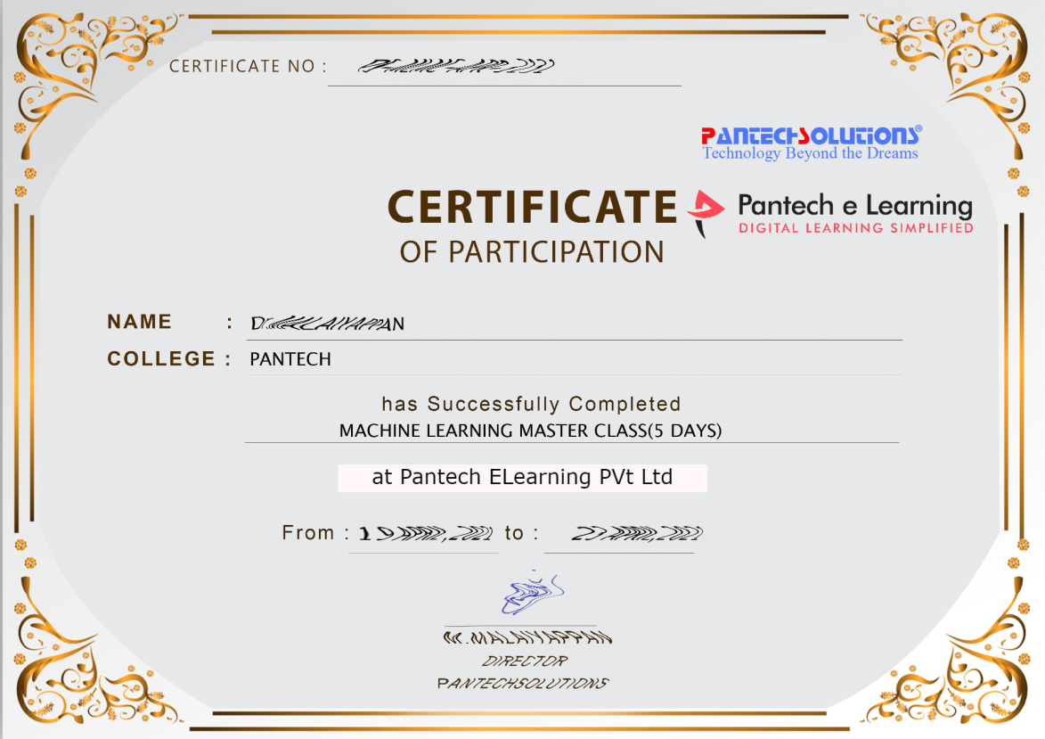

Sample Webinar Participation Certificate?

Slide 17
https://www.pantechelearning.com/data-science-master-class/
On Demand
You can get chance to apply 1 Month Internship on Data Science & Analytics Master Class

Slide 18
What is Internship????
Learn
Practice
Verify
Get Certified
Grow

Slide 19
Free Master Class DSA | 1 Month Internship on DSA
Master Class Participation Certificate | Internship Completion Certificate
Minimum 25 Class should attend YouTube Live | Recorded Class Link will be provided. – LMS Portal Access
YouTube Live Mandatory | Your Choice. You can attend Live or else You can watch Recorded Class in LMS Portal
All Projects Demo class in YouTube Live | Step by Step Video Explanation Content in LMS Portal
Access : 3 Days | VIP WhatsApp Group Support
 | You Can Download All PPTs
 | 4 Nos of Hackathon Class in Zoom Live. The Recording also will be provided
 | You Can Download All Project Files
 | Mentor will guide you to finish 10 Projects
 | Access : 60 Days

Slide 20
Pantech will make you to Create 10 Projects in Data Science & Analytics in 30 Days
Objective of this 30 Days Master Class

Slide 21
1 Month Internship in Data Science
INTERNSHIP E-Certificate(30Days Internship on Data Science Engineering)
Highly organized Video content
Download All Files
Download PPTs
Assignments
Flexible Time.
Access Period: 60Days from the date of payment

Slide 22
What You Will Get???
Complete Project Files
30 Days Learning Activity
Data Science Core Concepts
10 + Projects
Project PPT
Spatial Data Science For Covid-19 Disease Prediction
Parkinson’s Disease Prediction-XGBoost Classifier
House Price Prediction-Random Forest Regression
Customer Segmentation Using ML-K-Means Clustering
Home Loan Prediction-Decision Tree Classifier
Spam Classification-NLP
Hand Written Digit Recognition Using Python-CNN
Churn Prediction-Deep Learning
Crop Yield Prediction
Ground water level prediction
Video Class Access for 2 Months
Get chance to Enroll 1-Month Internship on demand

Slide 23

How to join in 1 month Internship
https://www.pantechelearning.com/data-science-master-class/
Click Here
Coupon Code: DSABATCH2

Slide 24
Overview of Pantech eLearning
Profile
Training
01
04
02
R & D
03
Services
Established on 2004 7 Wings 100+ Team Size
2000 + Workshops 300+ FDP’s 12.5 Lacs + Students
Industrial Design Services Lab Equipment Manufacturer Working on Funded Projects
Workshops, FDP’s Internships, Value Added Courses Online Training Project Guidance

Slide 25
Follow us on:
Instagram--https://instagram.com/pantechelearning?igshid=1fohp030onteu
Telegram--https://t.me/pantechelearning
YouTube--https://youtube.com/c/PantecheLearning.
Podcasts--https://www.instagram.com/tv/COPQIigJZFi/?igshid=4gjhz4dlls1p

Slide 26
Google colab:

Slide 27
Google Colab:
Google is doing a lot of research in artificial intelligence.
Google developed AI framework called tensorflow and development tool called google colab.
Colab supports GPU and it is totally free.
The use of colab has eased the learning and machine learning applications.
If you have jupyter notebook , it is easier to use colab.
Colab is a free jupyter notebook environment that runs in the cloud.

Slide 28
What Colab can do?
A programmer can do the following using google colab:
It does not require any setup. The notebooks you create can be simultaneously edited by the team members.
Write and execute code in python.
Records the code that supports mathematical equations.
Create/update/share notebooks.
Import/Save notebooks from/to google drive.
Import/publish notebooks from github.
Import external datasetse.g. From kaggle.
Combine with pytorch , tensorflow , keras and opencv.
Free cloud service with free GPU.

Slide 29
First Colab Notebook:
In this , we will create and execute our first notebook.
Colab implicitly uses google drive to store the notebooks and we have to make sure that we are logged into googledrive account before proceeding further.

Slide 30
Steps:
Open the following URL in your web browser.
https://colab.research.google.com
A dialog box will be displayed.
Click on new python 3 notebook link at the bottom of the screen.
A new notebook will open up.
The notebook interface is similar to what we observed in jupyter notebook.
There is a code window in which we can enter the python code.

Slide 31
Setting notebook name:
By default , the notebook uses the naming convention untitledxx.ipynb.
To rename this notebook , click on this notebook and type in the desired name in the edit box.
Type in the name in the edit box and press enter.
The notebook will acquire the name we have given.

Slide 32
Entering Code:
Type a simple python code and then press enter.
Enter the two python statements in the code window.
Import time
Print(time.ctime())

Slide 33
Executing Code:
To execute the code , click on the arrow on the left side of the code window.
After some time , we will see the output under the code window.
We can clear the output anytime by clicking the icon on the left side of the output display.

Slide 34
Adding more code cells:
To add more code to our notebook, select the following menu options.
Insert/code cell
Move the mouse at the bottom center of the code cell.
When the code and the text buttons appear , click on the code to add a new cell.
A new code cell will be added underneath the current cell.
Add the two statements in the currently created code window.
Time.sleep(5)
Print(time.ctime())

Slide 35
Output:
Now , if we run this cell , we will be getting the following output:
Mon Jun 17 04:50:27 2019
The time difference between two strings is not more than 5 seconds.
Colab allows us to run all the code inside the notebook without any interruption.

Slide 36
Run All:
To run the entire code without any interruption , execute the following menu options.
Runtime / reset and run all.
We will note that the difference between two outputs is exactly 5 seconds.
The above action can be initiated by the following two menu options:
Runtime / Restart runtime…

Slide 37
Changing Cell Order:
When a notebook contains a large number of cells,we may come across situations where we want to change the order of execution of the cells.
We may do that by selecting the cell we want to move and clicking the up cell and down cell buttons.
We may click the buttons multiple times to move the cells for more than a single position.

Slide 38
Deleting a Cell:
During the project development , we may have introduced a few unwanted cells in our notebook.
We can remove such cells from our project quickly with a single click.
Click on the vertical dotted icon on the top right hand corner of the code cell.
Click on the delete cell option and the current cell will be deleted.
In the next chapter ,we are going to explore other important capabilities of colab.

Slide 39
Google Colab – Documenting the code:
Python comments can be added in the code window to describe our code.
We may need more than simple text based comment to illustrate the algorithm.
ML uses mathematics and to describe the terms , it uses Latex – a language for mathematical representations.
Colab provides text cells for this purpose.

Slide 40
Markdown Examples:
Text cells are formatted using markdown , a simple markup language.
Let us see how to add text cells to our notebook and add some text containing mathematical equations.

Slide 41
Markdown Examples:
We will look into few markup language syntax to showcase its capabilities.
Type the following text in the text cell:
This is **bold**.
This is *italic*.
This is ~strikethrough~.

Slide 42
Output:
This is bold
This is italic
This is strikethrough

Slide 43
Mathematical Equations:
Add a text cell to your notebook and enter the markdown syntax in the text window:
$\sqrt{3x-1}+(1+x)^2$

Slide 44
Code For Sample Equations:
Constraints are - $3x_1 + 6x_2 + x_3 =< 28$ - $7x_1 + 3x_2 + 2x_3 =< 37$ - $4x_1 + 5x_2 + 2x_3 =< 19$ - $x_1,x_2,x_3 >=0 $ The trial vector is calculated as follows: - $u_i(t) = x_i(t) + \beta(\hat{x}(t) − x_i(t)) + \beta \sum_{k = 1}^{n_v}(x_{i1,k}(t) − x_{i2,k}(t))$ $f(x_1, x_2) = 20 + e - 20exp(-0.2 \sqrt {\frac {1}{n} (x_1^2 + x_2^2)}) - exp (\frac {1}{n}(cos(2\pi x_1) + cos(2\pi x_2))$ $x ∈ [-5, 5]$ >$A_{m,n} = \begin{pmatrix} a_{1,1} > a_{1,2} > \cdots > a_{1,n} \\ a_{2,1} > a_{2,2} > \cdots > a_{2,n} \\ \vdots > \vdots > \ddots > \vdots \\ a_{m,1} > a_{m,2} > \cdots > a_{m,n} \end{pmatrix}$

Slide 45
Google Colab – Saving our Work:
Google colab allows us to save our work in google drive or directly to our github repository.
Saving To Google Drive:
Colab allows us to save our work in google drive.
To save our notebook, select the following menu options.
File / Save a copy in Drive…
The action will create a copy of our notebook and save it in the drive.

Slide 46
Saving to Github:
We may also save our work to github repository.
Save the work in github repository by following the menu options.
File / Save a copy in GitHub...
We need to wait until we see the login screen to github.
Now, we have to enter the credentials.
If you don’t have a repository , create a new one and save the project.

Slide 47
Google Colab – Sharing Notebook:
To share the notebook we have created with our codevelopers , we have to share the copy that we made in the google drive.
To share the notebook to public audience , we may share it from Github Repositiry.
One more way to share our link is to click the share icon on the top right-hand corner of the notebook.

Slide 48
Google Colab – Sharing Notebook:
We have to share the email ids of people with whom we have to share the entire document.
Click on the getsharable option to get the URL of our notebook.
We will find the link for whom to share:
Specified group of people
Colleagues in our organisation
Anyone with the link.
All public on the web.

Slide 49
Google Colab – Invoking System Commands:
Jupyter includes shortcuts for many common system operations.
Colab code cell supports this feature.

Slide 50
Simple Code Command:
Enter the following code in the code cell that uses the system command echo.
message = 'A Great Tutorial on Colab by Pantech!'
greeting = !echo -e '$message\n$message'
greeting
Now , if we run the cell , we will be getting the following output:
['A Great Tutorial on Colab by Tutorialspoint!', 'A Great Tutorial on Colab by Tutorialspoint!']

Slide 51
Getting Remote Data:
Take one example that loads the dataset from the remote server.
Type in the following command in the code cell:
!wget http://mlr.cs.umass.edu/ml/machine-learning-databases/adult/adult.data -P "/content/drive/My Drive/app"

Slide 52
Output:
If we run the code , we will be getting the following output:
--2019-06-20 10:09:53-- http://mlr.cs.umass.edu/ml/machine-learning-databases/adult/adult.data Resolving mlr.cs.umass.edu (mlr.cs.umass.edu)... 128.119.246.96 Connecting to mlr.cs.umass.edu (mlr.cs.umass.edu)|128.119.246.96|:80... connected. HTTP request sent, awaiting response... 200 OK Length: 3974305 (3.8M) [text/plain] Saving to: ‘/content/drive/My Drive/app/adult.data.1’ adult.data.1 100%[===================>] 3.79M 1.74MB/s in 2.2s 2019-06-20 10:09:56 (1.74 MB/s) - ‘/content/drive/My Drive/app/adult.data.1’ saved [3974305/3974305]

Slide 53
Cloning Git Repository:
We can clone the entire git repository into colab using git command.
To clone the keras tutorial , type the following command in the code cell.
!git clone https://github.com/wxs/keras-mnist-tutorial.git

Slide 54
Output:
After running the program , we will be getting the following output:
Cloning into 'keras-mnist-tutorial'... remote: Enumerating objects: 26, done. remote: Total 26 (delta 0), reused 0 (delta 0), pack-reused 26 Unpacking objects: 100% (26/26), done.
Once the repo is cloned, locate a Jupyter project (e.g. MINST in keras.ipyab) in it, right-click on the file name and select Open With / Colaboratory menu option to open the project in Colab.

Slide 55
System Aliases:
To create a list of shortcuts for the following operations, type the following command.
To execute a list of operations for the following shortcuts , execute the following command:
!ls /bin

Slide 56
Output:
bash* journalctl* sync* bunzip2* kill* systemctl* bzcat* kmod* systemd@ bzcmp@ less* systemd-ask-password* bzdiff* lessecho* systemd-escape* bzegrep@ lessfile@ systemd-hwdb* bzexe* lesskey* systemd-inhibit* bzfgrep@ lesspipe* systemd-machine-id-setup* bzgrep* ln* systemd-notify* bzip2* login* systemd-sysusers* bzip2recover* loginctl* systemd-tmpfiles* bzless@ ls* systemd-tty-ask-password-agent* bzmore* lsblk* tar* cat* lsmod@ tempfile* chgrp* mkdir* touch* chmod* mknod* true* chown* mktemp* udevadm* cp* more* ulockmgr_server* dash* mount* umount* date* mountpoint* uname* dd* mv* uncompress* df* networkctl* vdir* dir* nisdomainname@ wdctl* dmesg* pidof@ which* dnsdomainname@ ps* ypdomainname@ domainname@ pwd* zcat* echo* rbash@ zcmp* egrep* readlink* zdiff* false* rm* zegrep* fgrep* rmdir* zfgrep* findmnt* run-parts* zforce* fusermount* sed* zgrep* grep* sh@ zless* gunzip* sh.distrib@ zmore* gzexe* sleep* znew* gzip* stty* hostname* su*

Slide 57
Executing external python files:
If we have some python code already developed stored in our google drive.
Now , we have to load this code in colab for further modifications.
In this ,we will see how to load and run code stored in google drive.
Tools/Command palette

Slide 58
Mounting Drive:
Tools/Command Palette
Type a few letters like m in the search box to locate the mount command.
Select mount drive command from the list.
The following code will be inserted into the code cell.

Slide 59
Mounting Drive:
# Run this cell to mount your Google Drive. from google.colab import drive drive.mount('/content/drive')
Once you run this code , you will be asked to enter the authentication details.
Open the above URL in your browser.
You will be asked to login to your google account.
If you grant permission, you will get the code.
After a while , the drive will be mounted.
Now , we can use the contents of the drive in colab.

Slide 60
Running Python Code:
For eg, we have to run a file called hello.py stored in our google drive.
Type the following command in the code cell:
!python3 "/content/drive/My Drive/Colab Notebooks/hello.py"
The contents of hello.py are given.
print("Welcome to TutorialsPoint!")
Now , we will see the following output.
Welcome to TutorialsPoint!
Besides text outputs , Colab also supports graphical outputs.

Slide 61
Google Colab – Graphical Outputs
Colab also supports rich outputs such as charts.
import numpy as np
from matplotlib
import pyplot as plt
y = np.random.randn(100)
x = [x for x in range(len(y))]
plt.plot(x, y, '-')
plt.fill_between(x, y, 200, where = (y > 195), facecolor='g', alpha=0.6)
plt.title("Sample Plot")
plt.show()

Slide 62
Output:
Graphical output is shown in the output section of the code cell:
We can create and display several type of charts.

Slide 63
Google Colab – Code Editing Help
Present-day developers rely heavily on context-sensitive help to language and library syntaxes.
That is why IDEs are used.
Colab notebook editor provides this help.

Slide 64
Function list:
Do the following steps:
Step 1:Open a new notebook and type in the following code in the new cell:
Tensor = torch.
Suppose , we don’t know what are the various functions available in torch module.
We may ask for context-sensitive help on function names by pressing the tab key.
There is a dot after the torch keyword.
Without that , we won’t be getting the context help.
Select the desired function from the list and proceed with coding.

Slide 65
Function Documentation:
Colab gives you the documentation on any function or class as a context-sensitive help.
Type the following code in your code window −
Tensor = torch.cos(
Now, hit TAB and you will see the documentation on cos in the popup window as shown in the screenshot here. Note that you need to type in open parenthesis before hitting TAB.

Slide 66
Google Colab - Magics
It is a set of commands that provide minimium extensive command language.
There are two types of magics:
Line Magics
Cell Magics
Line Magics: It consists of a single line of command.
In case of line magics , it is prepended with a single % character.
Cell Magics: Cell magic covers the entire body of the code cell.
In case of cell magics , it is prepended with two %% characters.

Slide 67
Google Colab – Line Magics
Type the following code in your code cell.
%ldir
You will get the contents of the local directory something like this
drwxr-xr-x 3 root 4096 Jun 20 10:05 drive/
drwxr-xr-x 1 root 4096 May 31 16:17 sample_data/
Try the following command-
%history
This represents the complete history of commands that we have previously executed.

Slide 68
Cell Magics
Type the following code in your code cell.
Now , if we run %%html
<marquee style='width: 50%; color: Green;'>Welcome to India!</marquee>
this code , we will be getting the following message.
Now if we run the code, we will run the scrolling welcome message on the screen.

Slide 69
Cell Magics:
The following code will add SVG to your document.
%%html
<svg xmlns="https://www.w3.org/2000/svg" viewBox="0 0 600 400" width="400" height="400"> <rect x="10" y="00" width="300" height="100" rx="0" style="fill:orange; stroke:black; fill-opacity:1.0" /> <rect x="10" y="100" width="300" height="100" rx="0" style="fill:white; stroke:black; fill-opacity:1.0;" /> <rect x="10" y="200" width="300" height="100" rx="0" style="fill:green; stroke:black; fill-opacity:1.0;" /> </svg>

Slide 70
Magics List:
To get a complete list of supported magics, type the following command
%lsmagic

Slide 71
Output:
Available line magics: %alias %alias_magic %autocall %automagic %autosave %bookmark %cat %cd %clear %colors %config %connect_info %cp %debug %dhist %dirs %doctest_mode %ed %edit %env %gui %hist %history %killbgscripts %ldir %less %lf %lk %ll %load %load_ext %loadpy %logoff %logon %logstart %logstate %logstop %ls %lsmagic %lx %macro %magic %man %matplotlib %mkdir %more %mv %notebook %page %pastebin %pdb %pdef %pdoc %pfile %pinfo %pinfo2 %pip %popd %pprint %precision %profile %prun %psearch %psource %pushd %pwd %pycat %pylab %qtconsole %quickref %recall %rehashx %reload_ext %rep %rerun %reset %reset_selective %rm %rmdir %run %save %sc %set_env %shell %store %sx %system %tb %tensorflow_version %time %timeit %unalias %unload_ext %who %who_ls %whos %xdel %xmode Available cell magics: %%! %%HTML %%SVG %%bash %%bigquery %%capture %%debug %%file %%html %%javascript %%js %%latex %%perl %%prun %%pypy %%python %%python2 %%python3 %%ruby %%script %%sh %%shell %%svg %%sx %%system %%time %%timeit %%writefile Automagic is ON, % prefix IS NOT needed for line magics.

Slide 72
Google Colab – Adding Forms
Colab provides a useful utility called forms that accepts inputs from the user at runtime.
We will now see how to add forms to our notebook.

Slide 73
Adding Forms
In the previous lessons , we used the following code to create time delay.
import time
print(time.ctime())
time.sleep(5)
print (time.ctime())
Suppose we want a user to set a delay of 5 seconds instead of a fixed delay of 5 seconds.

Slide 74
Google Colab – Adding Forms
For this , we can add a form to the code cell to accept the sleep time.
Open a new notebook. Click on the options from the vertically –dotted menu.
A popup menu appears on the screen.
Select , add a form option.
It will add a form to your code cell with the default title.
To change the title of the form, click on the settings button(pencil-icon on the right)

Slide 75
Google Colab – Adding Forms
Change the form title to “Form” and save the form.
We may also use some other name of our choice.
Note that it adds @title to our code cell.
In the next section , we will see how to add input fields to the form.

Slide 76
Adding Form Fields:
To add a form field , click the options menu in the code cell.
Click on the form to reveal the submenus.
Select add a form field menu option. A dialog box appears.
Leave the form field type to input.
Change the variable name to sleeptime and set the variable type to integer.
Save the changes by clicking the save button.

Slide 77
Adding Form Fields:
Now the screen will change with the sleeptime variable added to the code.
Next , how to test the form by adding the sleeptime variable added to the code.

Slide 78
Testing Form:
Add a new code cell underneath the form cell.
import time
print(time.ctime())
time.sleep(sleeptime)
print (time.ctime())
It prints the current time , waits for a certain time and prints the new timestamp.
The amount of time that the program waits is set in the variable called sleeptime.

Slide 79
Testing Form:
Now , go back to the form and type in the value of 2 for the sleep time.
Select the following code
Runtime / Run all
It runs the entire code and we can see the output on the screen.
Note that it has taken the input value of 2 for our sleep time.
Try changing this to a different value and run all to see its effect.

Slide 80
Inputting Text:
To accept a text input in your form, enter the following code in the new code cell.
name = ‘India' #@param {type:"string"}
print(name)
Now , if you run the code cell, whatever the name on the form will be printed at the output.
By default , the following output will appear on the screen.
We may use the menu options as shown for the integer input to create a text input field.

Slide 81
Dropdown List:
To use a dropdown list to our form,we may use the following input.
color = 'green' #@param ["red", "green", "blue"] print(color)
This creates a dropdown list with three values. ["red", "green", "blue"]
The default value is “green”

Slide 82
Date Inputs:
Colab form allows you to accept dates in your form with validations.
Use the following code to input date into our code.
#@title Date fields
date_input = '2019-06-03' #@param
{type:"date"}
print(date_input)
Try inputting a wrong date and see the validations.

Slide 83
Colab:
So,we have seen how to use colab for creating and executing jupyter notebooks with our python code.
In the coming chapters,we will see how to install ML libraries in our notebook so that we can use those in our python notebooks.

Slide 84
Task:
Write a program to create a new form in colab that accepts a string and a drop-down list and print the output.

Slide 85
Follow us on:
Instagram--https://instagram.com/pantechelearning?igshid=1fohp030onteu
Telegram--https://t.me/pantechelearning
YouTube--https://youtube.com/c/PantecheLearning.
Podcasts--https://www.instagram.com/tv/COPQIigJZFi/?igshid=4gjhz4dlls1p

Slide 86
After Internship Registration what you have to do?
Login to www.pantechelearning.com
Access the Video on daily basis for next 30 Days. Practice the Concept and submit assignments
Ask your doubts in VIP Group. Group link is avail in your dashboard.
Finish all the videos and download your Certificate from your dashboard

Slide 87
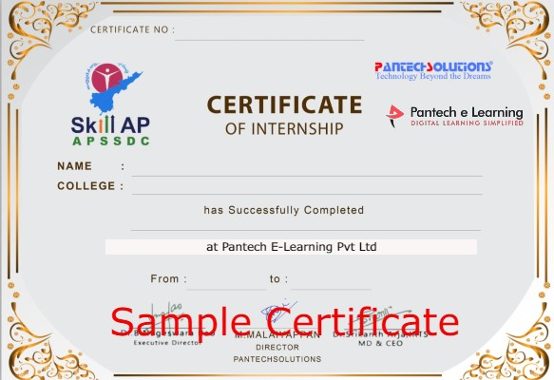
Internship Certificate (Sample)

Slide 88
Happy learning
30 Days Internship on Machine Learning Master Class
Reg Link: https://imjo.in/Rb6xqe
Discount Coupon Code: WELCOMEML
Call / whatsapp : +91 9840974408

Slide 89
THANKS
Further Information:
Senthil Kumar – 98409 74406
Srinivasan – 7010888841
Kumarasamy - 8925533489
www.pantechelearning.com | training@pantechmail.com

